Slide 1
Test Taking Strategies & Midterm Practice Exam
Test Taking Strategies, Midterm Practice Exam, Mock Exam Walkthrough, Revisiting the Metacognition Cycle

Slide 2
Lecture Outline
Test Taking Strategies
Maximizing Success on Exam Day
Midterm Practice Exam
Mock Exam, Debrief, and Reflection
Midterm Practice Exam Walkthrough
Solutions and Exploring Sample Rubrics
Revisiting the Metacognition Cycle
Applying Metacognition to Exams

Slide 3
Test Taking Strategies Discussion
What are some test taking strategies you have previously utilized in taking your exams?
Were those strategies you tried effective or not? Why?
How might you try a new test taking strategy on the CSE 390B midterm or any other upcoming exam?

Slide 4
Test Taking Best Practices
Survey the entire exam before beginning
Helps plan how much time to allocate for each problem
Read exam directions and question statements carefully
Use highlights, underlines, circles on important details
Answer the questions you feel the most confident in first
If stuck on a problem, make a mark on the problem and revisit the question later

Slide 5
Test Taking Best Practices
Prioritize how you will answer questions
Do this based on confidence level for each type of question or how long you think each will take
Rely on a methodological approach for each question
Helps make taking the test feel more systematic
If stuck on a question, demonstrate what you know
Many exams reward partial credit
If time allows, double check your answers
Catches any small mistakes that may have been made earlier

Slide 6
Lecture Outline
Test Taking Strategies
Maximizing Success on Exam Day
Midterm Practice Exam
Mock Exam, Debrief, and Reflection
Midterm Practice Exam Walkthrough
Solutions and Exploring Sample Rubrics
Revisiting the Metacognition Cycle
Applying Metacognition to Exams

Slide 7
Midterm Practice Exam
The exam is closed-note, closed-book
You may only use the midterm reference sheet
Questions are not necessarily in order of difficulty
You will have 25 minutes to complete the mock exam
We will give you a 5-minute warning
Remember to relax and take deep breaths

Slide 8
Mock Exam Debrief & Reflection
What did you learn about yourself through this process? About your test taking practices?
What are two test taking strategies that you would like to engage with in your next exam? Why?
What is one thing that can help you relax and calm down before or during your exam?

Slide 9
Five-minute Break!
Feel free to stand up, stretch, use the restroom, drink some water, review your notes, or ask questions
We’ll be back at:
Research shows mid-lecture breaks reduce the decline of attention in the middle of lecture (Olmsted, 1999)
Olmsted III, John. “The Mid-Lecture Break: When Less Is More.” Journal of Chemical Education (1999). https://pubs.acs.org/doi/abs/10.1021/ed076p525.

Slide 10
Lecture Outline
Test Taking Strategies
Maximizing Success on Exam Day
Midterm Practice Exam
Mock Exam, Debrief, and Reflection
Midterm Practice Exam Walkthrough
Solutions and Exploring Sample Rubrics
Revisiting the Metacognition Cycle
Applying Metacognition to Exams

Slide 11
Question 1: Circuit Design
Part a: Truth Table
A_{t} | B_{t} | A_{t+1} | B_{t+1}
1 | 1 | 1 | 0
1 | 0 | 0 | 1
0 | 1 | 0 | 0
0 | 0 | 1 | 1
11 → 10 → 01 → 00 → 11

Slide 12
Question 1: Circuit Design
Part a: Truth Table
A_{t} | B_{t} | A_{t+1} | B_{t+1}
1 | 1 | 1 | 0
1 | 0 | 0 | 1
0 | 1 | 0 | 0
0 | 0 | 1 | 1
11 → 10 → 01 → 00 → 11

Slide 13
Question 1: Circuit Design
Part a: Truth Table
A_{t} | B_{t} | A_{t+1} | B_{t+1}
1 | 1 | 1 | 0
1 | 0 | 0 | 1
0 | 1 | 0 | 0
0 | 0 | 1 | 1
A_{t+1} = (A_{t} & B_{t})
A_{t+1} = (~A_{t} & ~B_{t})
Part b: Boolean Expressions

Slide 14
Question 1: Circuit Design
Part a: Truth Table
A_{t} | B_{t} | A_{t+1} | B_{t+1}
1 | 1 | 1 | 0
1 | 0 | 0 | 1
0 | 1 | 0 | 0
0 | 0 | 1 | 1
A_{t+1} = (A_{t} & B_{t})
A_{t+1} = (~A_{t} & ~B_{t})
Part b: Boolean Expressions
A_{t+1} = (A_{t} & B_{t}) | (~A_{t} & ~B_{t})

Slide 15
Question 1: Circuit Design
Part a: Truth Table
A_{t} | B_{t} | A_{t+1} | B_{t+1}
1 | 1 | 1 | 0
1 | 0 | 0 | 1
0 | 1 | 0 | 0
0 | 0 | 1 | 1
A_{t+1} = (A_{t} & B_{t})
B_{t+1} = (A_{t} & ~B_{t})
A_{t+1} = (~A_{t} & ~B_{t})
B_{t+1} = (~A_{t} & ~B_{t})
Part b: Boolean Expressions
A_{t+1} = (A_{t} & B_{t}) | (~A_{t} & ~B_{t})
B_{t+1} = (A_{t} & ~B_{t}) | (~A_{t} & ~B_{t})
= ~B_{t} & (A_{t} | ~ A_{t}) [Factor out ~B_{t}]
= ~B_{t} [A_{t} | ~ A_{t} = 1]

Slide 16
Question 1: Circuit Design
Part a: Truth Table
Part c: Drawing the Circuit
A_{t} | B_{t} | A_{t+1} | B_{t+1}
1 | 1 | 1 | 0
1 | 0 | 0 | 1
0 | 1 | 0 | 0
0 | 0 | 1 | 1
Part b: Boolean Expressions
A_{t+1} = (A_{t} & B_{t}) | (~A_{t} & ~B_{t})
B_{t+1} = (A_{t} & ~B_{t}) | (~A_{t} & ~B_{t})
= ~B_{t} & (A_{t} | ~ A_{t}) [Factor out ~B_{t}]
= ~B_{t} [A_{t} | ~ A_{t} = 1]

Slide 17
Question 1: Circuit Design Sample Rubric
Category | Points | Criteria
Truth Table | 4 points | 1 point for each row in the truth table that is correct
Boolean Expressions | 6 points | 4 points for correct expression for A_{t+1} 2 points if truth table is wrong but expression matches truth table 2 points for correct expression for B_{t+1} 1 point if truth table is wrong but expression matches truth table
Circuit Diagram | 5 points | 3 points for having circuits that match the Boolean expressions in part b 2 points for fully correct diagram
Total | 15 points

Slide 18
Question 2: Math Puzzle
Dana needs 300 pickets for her colorful picket fence. She wants equal amounts of each of her 4 selected colors. She already has 32 red, 26 green, 9 yellow, and no blue. If the pickets cost 25 cents and you get 20% off if you purchase 50 or more of the same color, and 30% off if you purchase 60 or more of one color, how much does Dana need to spend? List your answer to two decimal places. You may use a calculator application on your computer to solve this problem.

Slide 19
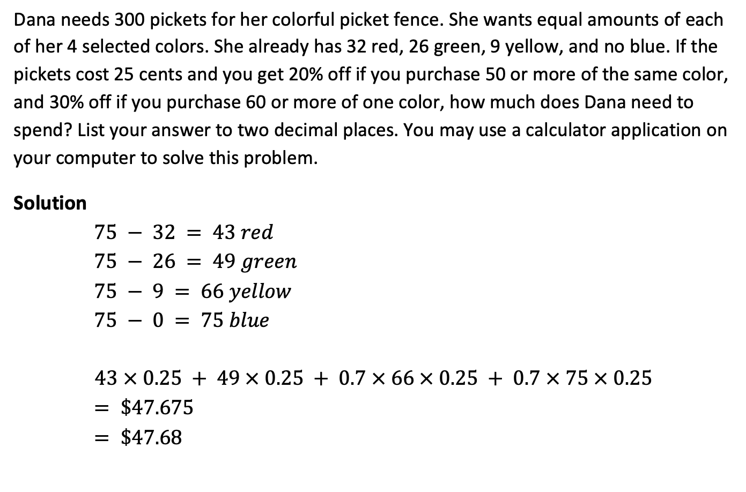
Question 2: Math Puzzle
Dana needs 300 pickets for her colorful picket fence. She wants equal amounts of each of her 4 selected colors. She already has 32 red, 26 green, 9 yellow, and no blue. If the pickets cost 25 cents and you get 20% off if you purchase 50 or more of the same color, and 30% off if you purchase 60 or more of one color, how much does Dana need to spend? List your answer to two decimal places. You may use a calculator application on your computer to solve this problem.
Solution
$75 − 32 = 43 red$
$75 − 26 = 49 green$
$75 − 9 = 66 yellow$
$75 − 0 = 75 blue$
$$43 × 0.25 + 49 × 0.25 + 0.7 × 66 × 0.25 + 0.7 × 75 × 0.25$$
$= \$47.675$
$= \$47.68$
(Rounding down is also acceptable)

Slide 20
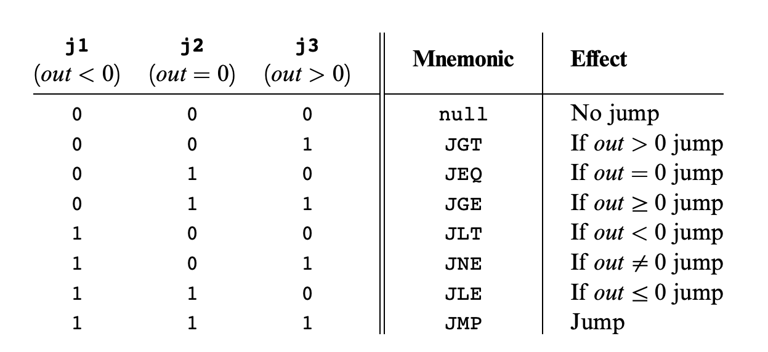
Question 3: Hack Assembly Programming
Write a Hack assembly program that stores -1, 0, or 1 in R1 based on the sign of R0. To be more specific, your program should store a -1 in R1 if R0 is negative, a 0 in R1 if R0 is 0, and a 1 in R1 if R0 is positive.

Slide 21
Question 3: Hack Assembly Programming
Write a Hack assembly program that stores -1, 0, or 1 in R1 based on the sign of R0. To be more specific, your program should store a -1 in R1 if R0 is negative, a 0 in R1 if R0 is 0, and a 1 in R1 if R0 is positive.
Equivalent pseudocode:
if (R0 < 0){
R1 = -1;
} else if (R0 > 0){
R1 = 1;
} else { //R0 == 0
R1 = 0;
}

Slide 22
Question 3: Hack Assembly Programming
One solution:
@R0
D = M
@NEGATIVE
D; JLT
@POSITIVE
D; JGT
// R0 == 0 case
@R1
M = 0
@END
0; JMP
(NEGATIVE)
// R0 < 0 case
@R1
M = -1
@END
0; JMP
(POSITIVE)
// R0 > 0 case
@R1
M = 1
(END)
@END
0; JMP
Write a Hack assembly program that stores -1, 0, or 1 in R1 based on the sign of R0. To be more specific, your program should store a -1 in R1 if R0 is negative, a 0 in R1 if R0 is 0, and a 1 in R1 if R0 is positive.
Equivalent pseudocode:
if (R0 < 0){
R1 = -1;
} else if (R0 > 0){
R1 = 1;
} else { //R0 == 0
R1 = 0;
}

Slide 23
Question 3: Hack Assembly Sample Rubric
Category | Points | Criteria
Has Infinite End Loop | 1 point | 1 point if program has an Infinite End Loop
Conditional Checks | 4 points | 2 points for having at least two checks for cases. Almost all solutions will need a check for 2 of the three cases (negative, zero, positive). 2 points for correctly matching jump condition to cases (e.g. jump to negative case when negative, etc.)
Assigns Correct R1 Value | 3 points | One point for each case: negative: R1 = -1 zero: R1 = 0 positive: R = 1
Fully Correct Implementation | 2 points | Covers any little mistakes that may result in an incorrect implementation (e.g., forgetting to jump to the end when a case is done)
Total | 10 points

Slide 24
Question 4: Metacognitive Skills
Name two metacognitive skills that we have covered in CSE 390B thus far.

Slide 25
Lecture Outline
Test Taking Strategies
Maximizing Success on Exam Day
Midterm Practice Exam
Mock Exam, Debrief, and Reflection
Midterm Practice Exam Walkthrough
Solutions and Exploring Sample Rubrics
Revisiting the Metacognition Cycle
Applying Metacognition to Exams

Slide 26
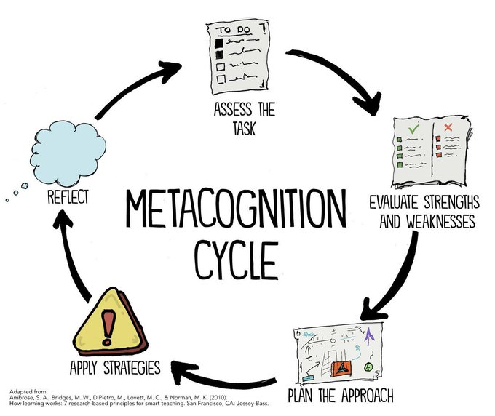
Revisiting the Metacognition Cycle

Slide 27
Revisiting the Metacognition Cycle
Self-assessing your current test taking practices

Slide 28
Revisiting the Metacognition Cycle
Self-assessing your current test taking practices
What test taking strategies are you engaging with?

Slide 29
Revisiting the Metacognition Cycle
Self-assessing your current test taking practices
What test taking strategies are you engaging with?
Creating a plan for strengthening your test-taking practices

Slide 30
Revisiting the Metacognition Cycle
Self-assessing your current test taking practices
What test taking strategies are you engaging with?
We’ve conveniently done this before your midterm!
Creating a plan for strengthening your test-taking practices

Slide 31
Revisiting the Metacognition Cycle
Self-assessing your current test taking practices
Post-midterm debrief
What test taking strategies are you engaging with?
We’ve conveniently done this before your midterm!
Creating a plan for strengthening your test-taking practices

Slide 32
Lecture 11 Wrap-up
CSE 390B Midterm Exam this Thursday (5/5) during lecture at 2:30pm
Project 6: Mock Exam Problem & Building a Computer due next Thursday (5/12) at 11:59pm PDT

